Slide 1

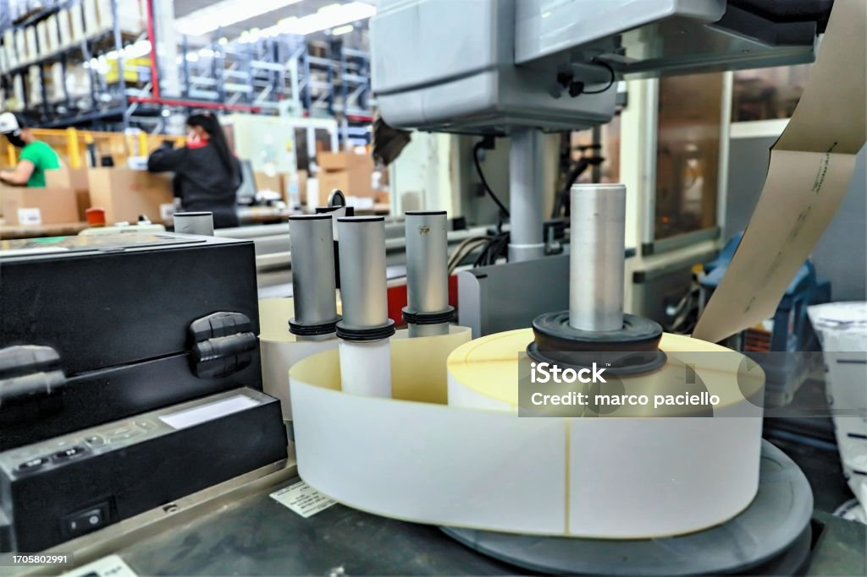
MANUFACTURING ANALYSIS
P947
GROUP-2
A PRESENTATION ON
GROUP MEMBERS:
Priyvrith Pandey
Monali Rajendra Kadhane
Hariom Chaudhary
Mohita Dashora
Ahmed Mohamed Alhassan Abashar
Akshay Srikant Deo

Slide 2

Contents
Summary
Excel
PowerBi
Tableau
MY SQL
Key Learnings
KPIs
Recommendation
Conclusion

Slide 3
Project Summary
Purpose: To analyze production data from Axon Label's manufacturing operations to identify inefficiencies, assess product quality, and drive process optimization.
Focus: Evaluation of production efficiency (e.g., Pressed, Processed, and Produced Quantities)Analysis of quality metrics like Rejected Quantity Monitoring machine performance and operation trends
Data Source: Internal Axon Label manufacturing records collected from production and quality control systems. (Duration 1 year)
Dataset Details: The dataset contains 10,000 records with fields such as:Produced_Qty, Rejected_Qty, Per_Day_Machine_Cost, Machine_Code, Operation_Name , Customer_data as well.
Outcome: Recommendations to improve manufacturing process, machine efficiency, find rejection causes and try to improve, optimize production quantity, and insure quality checks .

Slide 4
Manufacture Qty : 61M
Rejected Qty : 491K
Processed Qty : 60M
Wastage Qty : 0.82%
Employee Wise Rejected Qty: Amit Kumar has most Rejected Qty
Machine Wise Rejected Qty: MC094 has most Rejected Qty
Department Wise Manufacture Vs Rejected : Woven labels
Production Comparison trend : March month has peak production
KPIs

Slide 5

EXCEL
DASHBOARD

Slide 6
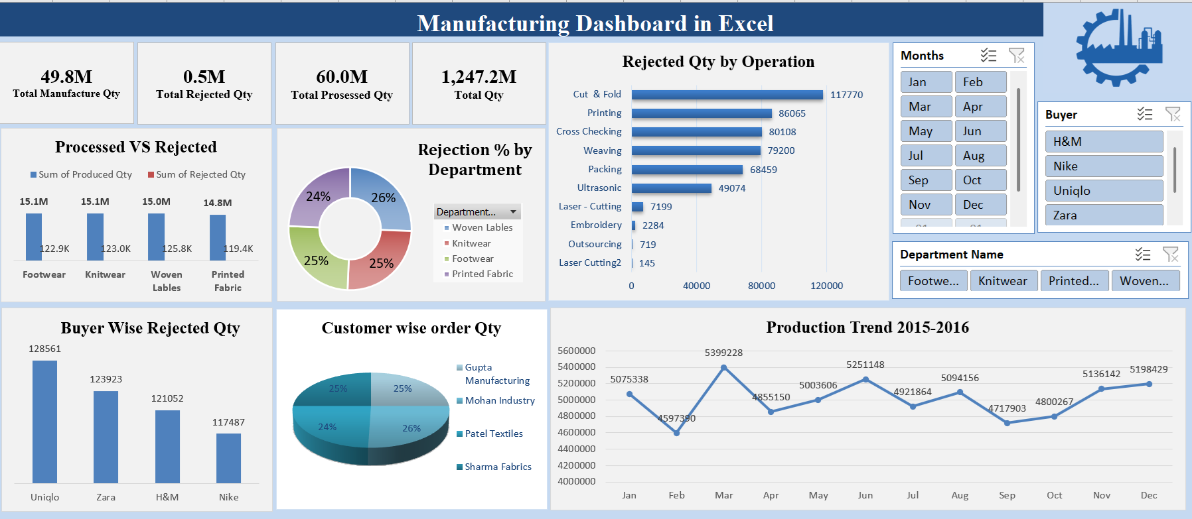

Slide 7

POWERBI
DASHBOARD

Slide 8
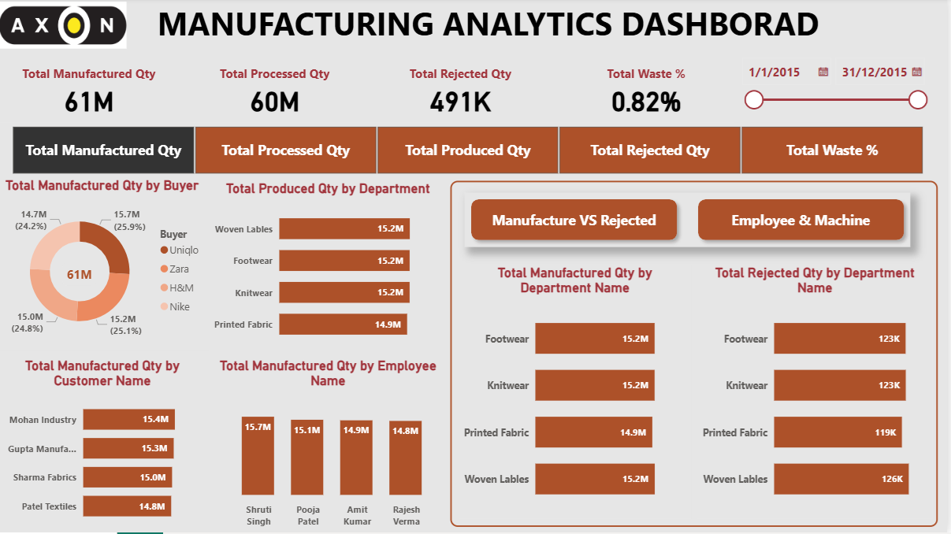

Slide 9

TABLEAU
DASHBOARD

Slide 10
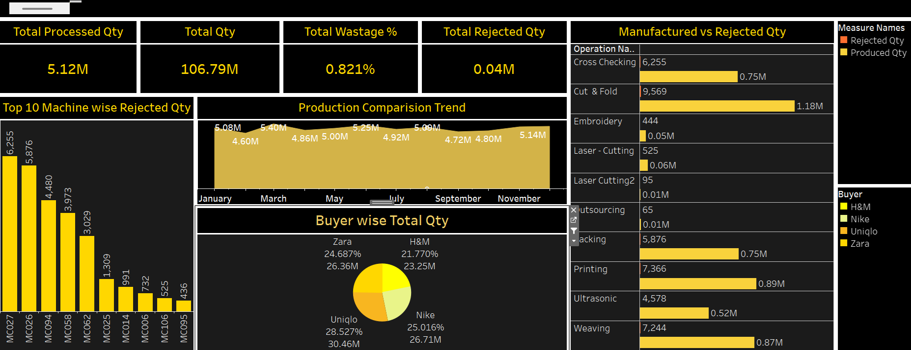

Slide 11
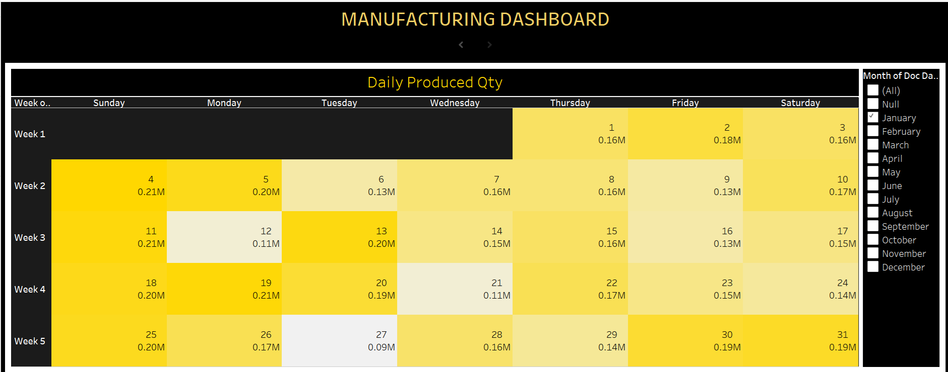

Slide 12

MY SQL QUERIES
DASHBOARD

Slide 13
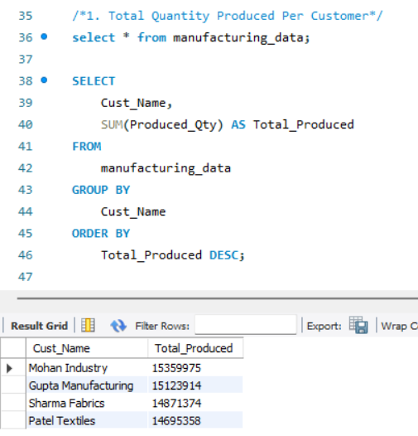
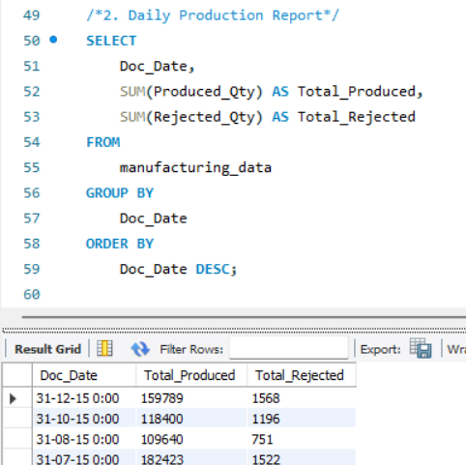
QUERIES

Slide 14
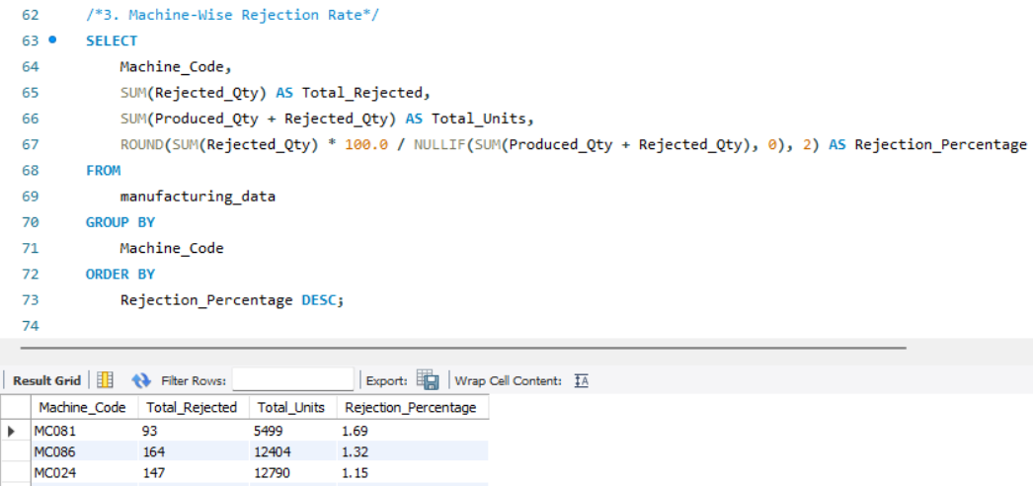
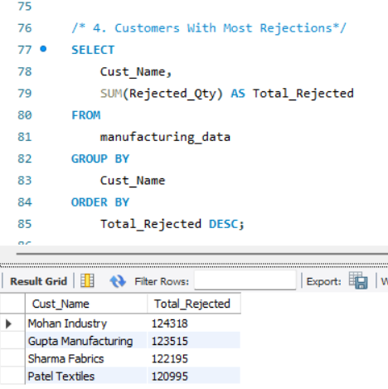
QUERIES

Slide 15
Key Learnings
The repetition of jobs (e.g., 1,075 repeated jobs) suggested underlying issues in quality control or operator training, requiring root cause analysis.
Department-wise rejection showed that Woven Labels had a significant rejection rate, which suggests possible issues in process standardization or raw material quality.
March was identified as the peak production month, giving valuable insight into demand cycles and resource planning.
Among all operations, Cut & Fold and Printing had the highest rejection counts, indicating a need to focus process improvement efforts there.
Employee-wise analysis revealed that rejections were concentrated among specific staff (e.g., Amit Kumar), highlighting a need for targeted training.

Slide 16
Recommendations
Fix Production & Quality Issues:
Investigate Machine MC027, which has the highest rejection rate (80,108 rejected units).
Review top 5 machines with high rejection and prioritize preventive maintenance or recalibration
Focus on high Repeat counts (e.g., 1,075 jobs repeated 8+ times) – identify root causes for rework or failed QC..
Optimize Machine Load & Cost:
Redistribute load from overused machines (e.g., MC033 and MC027) to less-utilized ones (total: 86 machines available).
Leverage underused departments (only 4 total) and promote cross-department coordination to smooth workload.
Enhance Monitoring & Train Employee:
Build real-time dashboards for key KPIs. Use these insights to drive weekly operational reviews and continuous improvement.
Find and Provide Training to underperforming employees to improve efficiency.
Standardize Operations:
Focus improvement efforts on the most common operations: Cut & Fold (2,374 jobs)Printing, Weaving, Cross Checking

Slide 17
Conclusion
The project transformed raw manufacturing data into actionable insights.
Dashboards built with Excel, Power BI, and Tableau revealed hidden inefficiencies and high rejection points.
We identified areas for improvement in machine usage, employee performance, and departmental output.
This project proved how data analytics can enhance decision-making, reduce waste, and improve operational efficiency.
It was a valuable experience that combined technical tools with real-world manufacturing challenges

Slide 18


